Slide 1
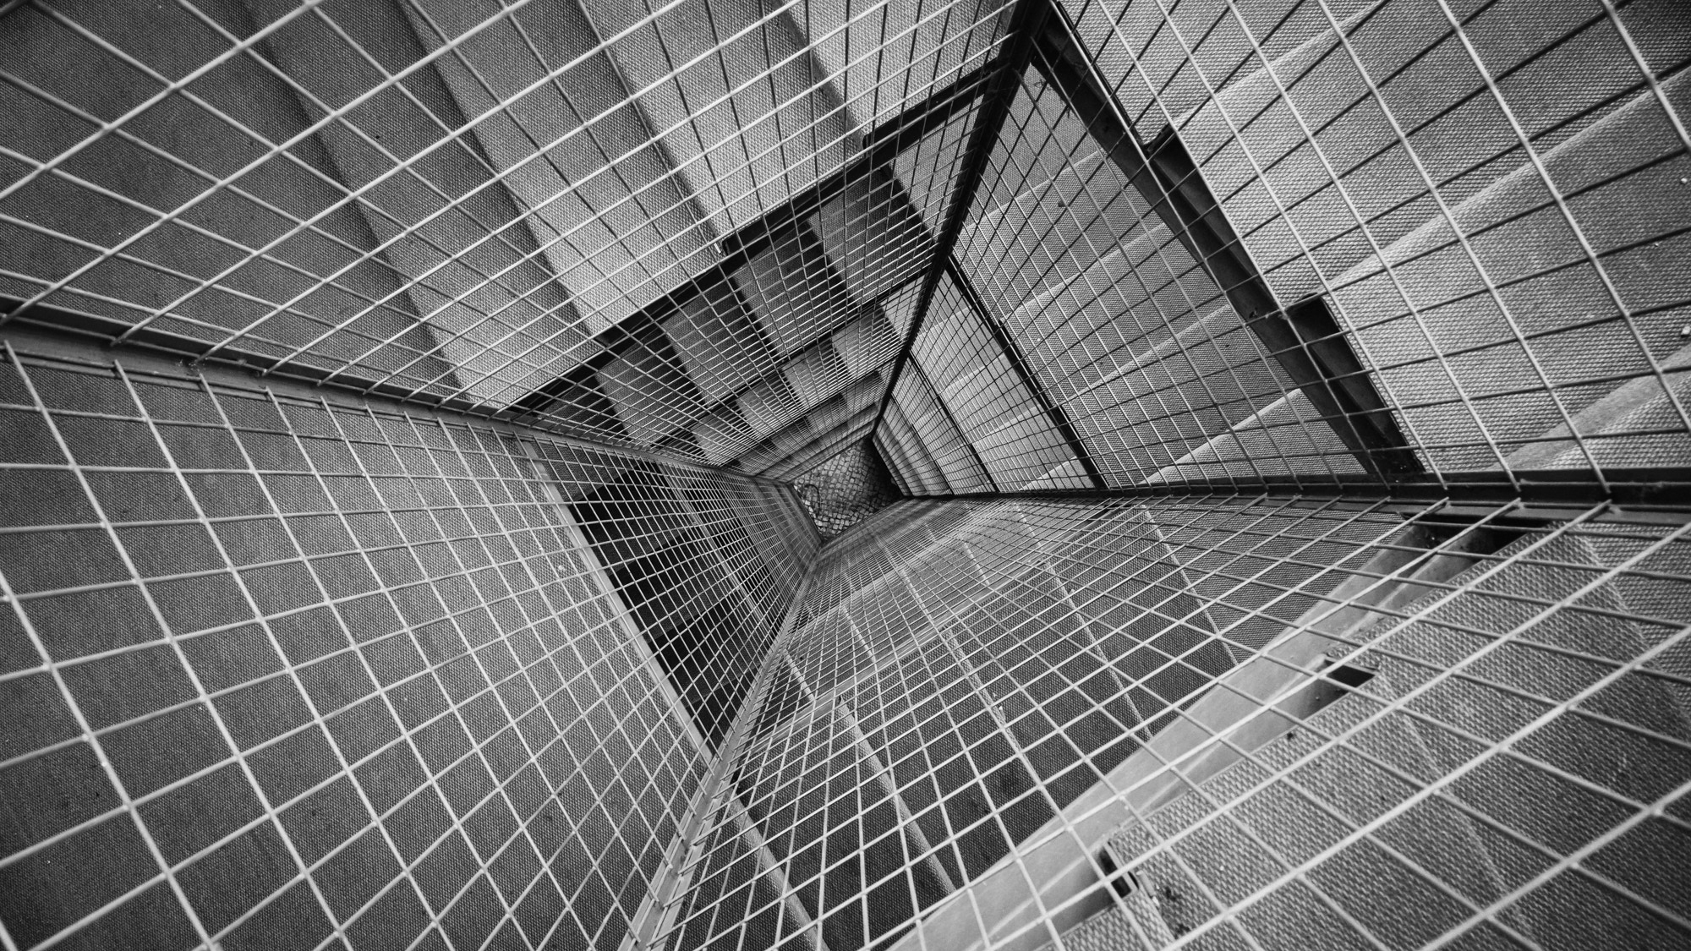
TOTAL TECHNOLOGY
REPORTLAB COMPLETE TUTORIAL
How to create PORTRAIT & LANDSCAPE ORIENTATION in pdf
Tutorial 49

Slide 2
HOW TO CREATE PORTRAIT ORIENTATION WITH CUSTOM SIZE IN PDF:
from reportlab.pdfgen import canvas
from reportlab.lib.pagesizes import letter,landscape
from reportlab.lib.units import cm
pdf=canvas.Canvas("tutorial49.pdf")
pdf.setPageSize([100,900])
pdf.translate(cm, cm)
pdf.drawCentredString(30,50,"portrait orientation")
pdf.save()
TOTAL TECHNOLOGY

Slide 3
HOW TO CREATE LANDSCAPE ORIENTATION IN PDF:
from reportlab.pdfgen import canvas
from reportlab.lib.pagesizes import letter,landscape
from reportlab.lib.units import cm
pdf=canvas.Canvas("tutorial49.pdf",pagesize=letter)
pdf.translate(cm, cm)
pdf.setPageSize(landscape(letter))
pdf.drawCentredString(30,50,"landscape")
pdf.save()
TOTAL TECHNOLOGY

Slide 4
HOW TO CREATE LANDSCAPE ORIENTATION WITH CUSTOM SIZE IN PDF:
from reportlab.pdfgen import canvas
from reportlab.lib.pagesizes import letter,landscape
from reportlab.lib.units import cm
pdf=canvas.Canvas("tutorial49.pdf")
pdf.translate(cm, cm)
pdf.setPageSize([950,550])
pdf.drawCentredString(30,50,"landscape")
pdf.save()
TOTAL TECHNOLOGY

